Slide 1

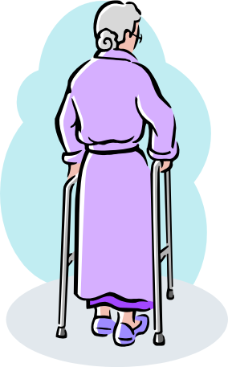

Topic 1 (Choose only one topic either Topic1
or 2)
中大五医院 is going to build a remote health care system for elderly citizens who live alone in Zhuahi.
Suppose you are system(&network) engineer of the hospital. How would you design the remote health care system? Draw possible architecture.
Describe your system by three architectures on three pages(slides).
(hints : ecg, tilt and motion sensor in chapter1)

Slide 2
Topic2: Describe the mechanism of Windows10 update function.
2-pages
Windows 10 automatically downloads and installs updates to make sure your device is secure and up to date. This means you receive the latest fixes and security updates, helping your device run efficiently and stay protected. In most cases, restarting your device

